Slide 1
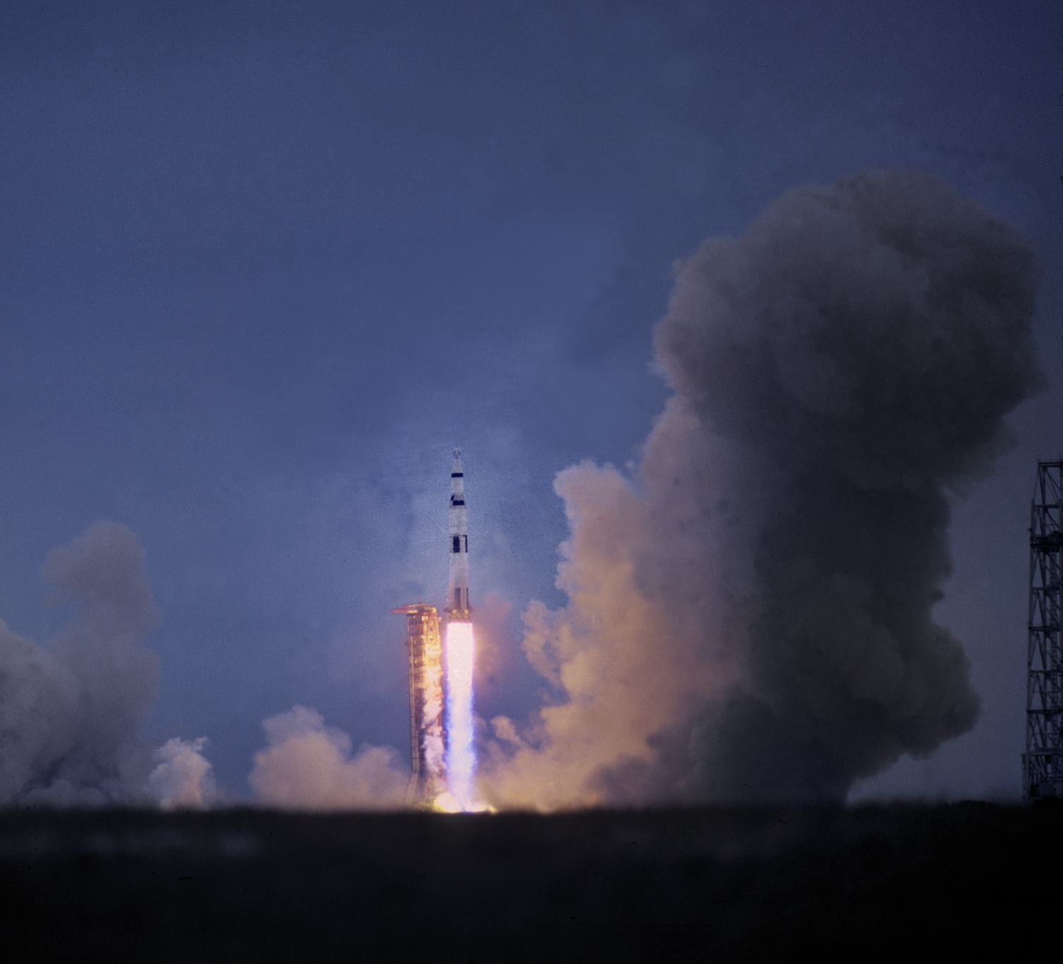
NASA Visualization

Slide 2

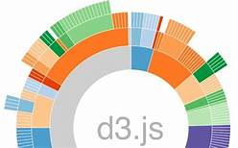

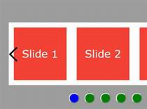


NASA Viz - Architecture
Asteroids
Planets
NASA

Slide 3
NASA Viz - Components
HTML homepage
Carousel JS library
Python powered flask web server used to
API based JSON download from NASA(https://api.nasa.gov/api.html)
Convered to XLS
Load into postgres database
Exportted to smaller XLS
HTML, css, Javascript and D3
Asterioids
Kepler systems and Planets
To switch between various views in the dashboard
Multiple visualizations of individual and combined datasets using new Javascript and D3 libraries

